Slide 1
WordPress 5.5
features, updates and upgrades
Notes:
Intro - abha
Take questions at the end please hold to end as we are recording this for other meetups

Slide 2
WordPress 5.5
Auto-updates of Themes and Plugins
Sitemaps XML
Browser-based images lazy loading
Gutenberg updates
The Block Directory
Notes:
Abha

Slide 3


1. Auto-updates
You can pick which theme or plugin you want to auto-update
Plugins
Themes
Notes:
Abha - hand over to Chris
( NOTE TO CHRIS KEEP POSTURE UP MIC AWAY AND MAKE SURE YOU CAN SEE LIPS) Thank you for the introduction Abha ,
To to kick of and delve into the heart of this presentation this initial piece will cover a huge part of the 5.5 release which is AUTO UPDATES!!! We would like to prefix this next section with a couple of caveats and dispel some common misconceptions around 5.5:
Auto-updates are ONLY for minor release versions, that means that WordPress should never auto update and break your site if you don’t opt into major release auto-updates, this mean that WP will update 5.5.1 to 5.5.2 versions NOT 5.6 nor 6.0. Auto-updates for minor releases have been in WP core for quite a few versions now and the main focus of 5.5 was to move that functionality over to plugins. It does that by adding a new interface into the plugins page in admin ( I will show you an example in the coming slides) and the second caveat I would like to add in here is ( LEAD TO NEXT SLIDE!!! )
Mention that auto-updates for minor releases to core (eg 5.5.1 - not major releases ) were introduced previously, and this 5.5 is only focused on Plugins / Themes auto updates new additional column on the plugins section of your site (lead to next slide).

Slide 4
By keeping your plugins and themes up to date you make your WordPress website more secure.
Tip
Easily control which plugins and themes you want to enable auto-update for.
Notes:
Chris:
WordPress is software and as such it’s an ever evolving organism, all software evolves as technology improves and because of that potential vulnerabilities ,bugs or holes potentially may appear, By keeping your site, plugins and themes updated you are making sure you patch any holes or enable any new functionality as it’s released.
How do you go about doing these updates the RIGHT way:
One of the major points that we can’t recommend enough is that even if you choose to enable auto updates or NOT you should always have a robust backup solution in place, that could be either via a third party service, your host or you could manually perform the backups yourself. Whatever path you choose to pursue if you keep regular backups then keeping your plugins and themes up to date poses no worries and little risk, if you run into a compatibility issue roll the website back to a previous version and perform the updates manually to diagnose the issue.

Slide 5
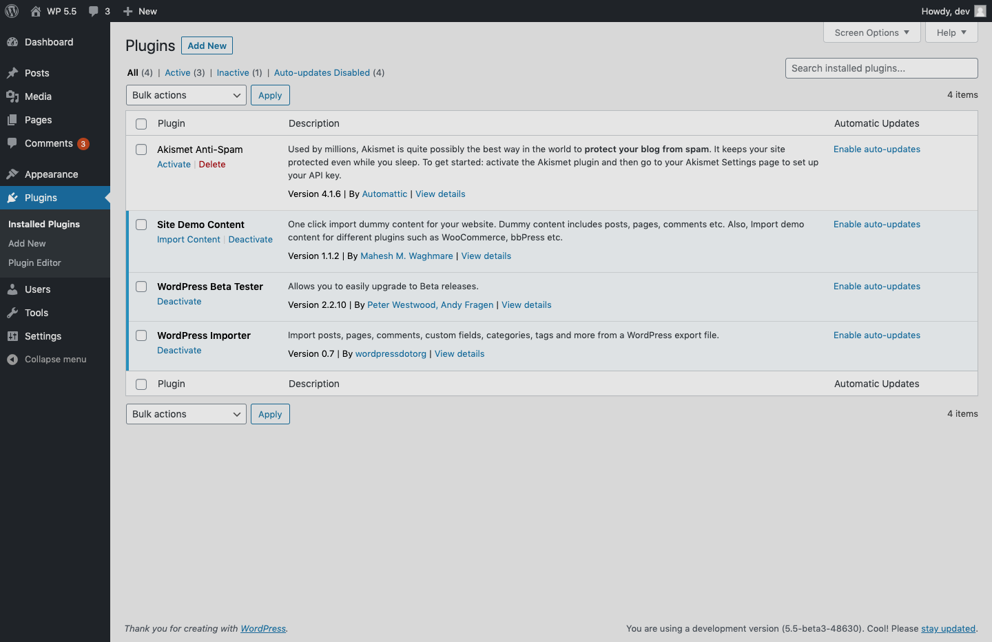

Tip
You can disable auto-update if plugin is mission-critical for your website and there is known history of bugs being introduced in new versions
Notes:
Chris -
This was the screenshot promised earlier, this indicates the new User interface design of the plugins page in your WordPress admin, notice the new column on the right hand side of the screen this show every plugin and it’s current auto update status, be it enabled or disabled. This interface allows you to enable auto-update for particular plugins and allows you to turn it off for others ( I.E you may want to disable this on mission critical plugins/themes )

Slide 6
2. jQuery updates in 5.5
Why is WP choosing to update jQuery
Enable jQuery Migrate Helper plugin
What’s coming next 5.6
Notes:
Chris:
WordPress has been running on a VERY old version of jQuery for many years now and lagging behind the rest of the internet, because of this in 5.5 the WP core team took the brave step of pushing jQuery to the latest stable version, they have chosen to do this in a stepped approach.
Step one: was released in WP 5.5 which is removing an old jQuery dependency called jQuery migrate
The WordPress.org core team have put together a plugin to re-enable the first file that was removed in 5.5 to help mitigate potential issues and give the plugin and theme authors time to perform the needed updates.
This plugin is called “enable jquery migrate helper” and can be found on the plugin repo
After installing this plugin, many people have found that a lot of the errors they have experianced during the 5.5 update have disappeared.
Step two: planned for wp 5.6 will be to fully remove the old version of jQuery and to help with this migration they have also provided a great plugin called: “Test jQuery updates”
You SHOULD enable this plugin on any sites you maintain and test the newest version of jQuery ( ideally on a staging site ;) ) this will illustrate any errors that may occur, and enable you to fix them before the 5.6 update comes out.
https://wordpress.org/plugins/enable-jquery-migrate-helper/

Slide 7
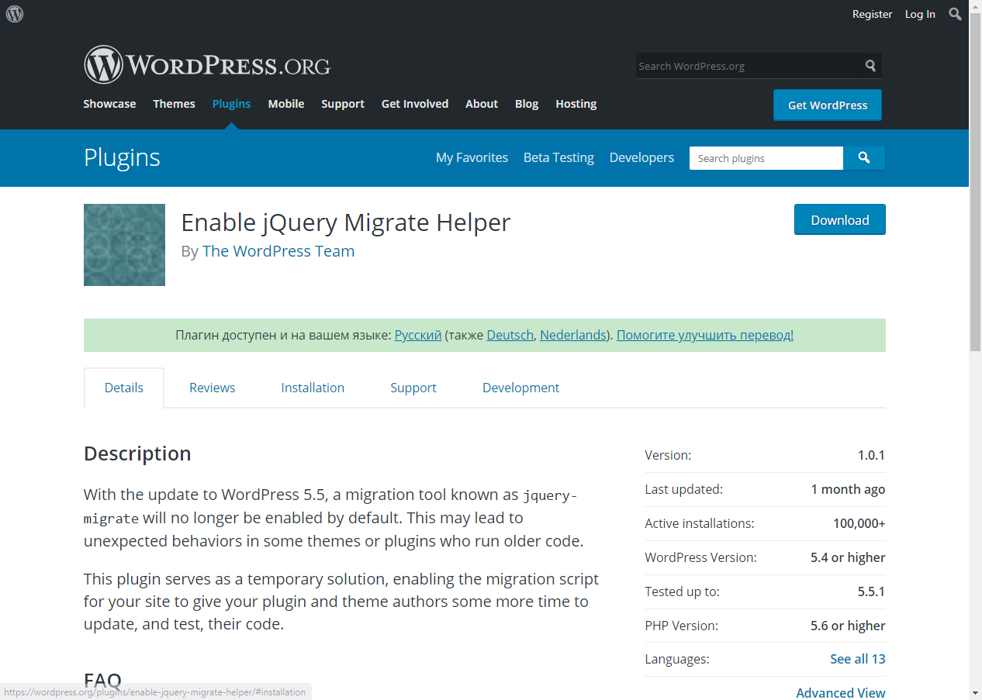
Enable jQuery Migrate Helper
Notes:
JUST RECAP HOW TO FIND THIS

Slide 8
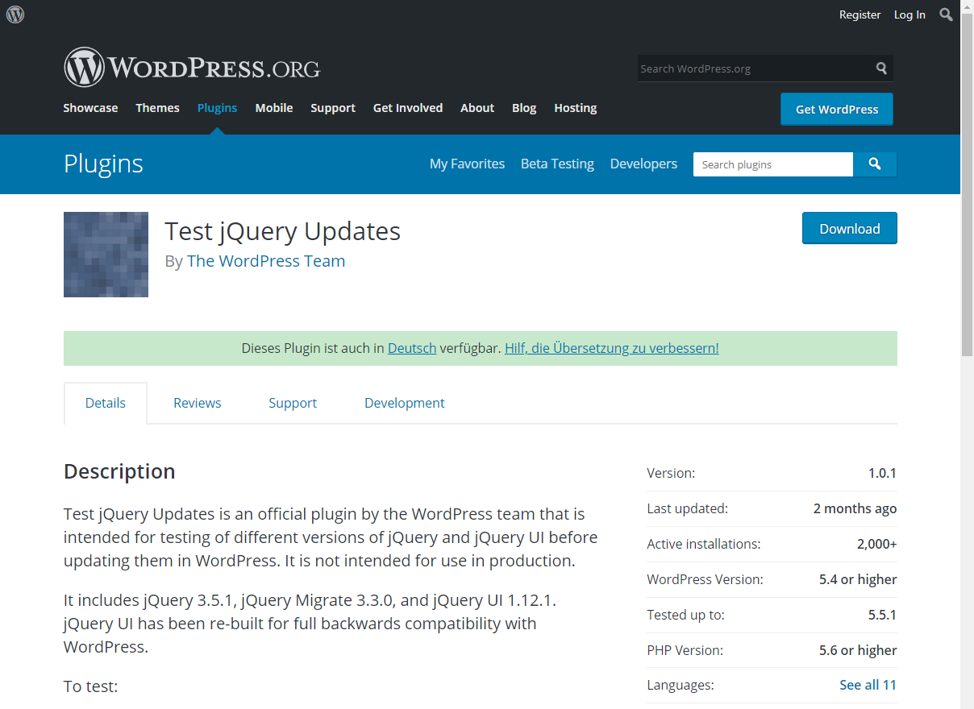
Test jQuery Updates
Notes:
JUST RECAP THIS TO REINFORCE THIS

Slide 9
3. Sitemaps
Sitemaps help the webmaster to inform the search engine which URLs of your site it can crawl
No plugins
Developer-friendly
Notes:
Nemanja
Sitemaps.org says: Web crawlers usually discover pages from links within the site and from other sites. Sitemaps supplement this data to allow crawlers that support Sitemaps to pick up all URLs in the Sitemap and learn about those URLs using the associated metadata. Using the Sitemap protocol does not guarantee that web pages are included in search engines, but provides hints for web crawlers to do a better job of crawling your site.
In other words: A good XML sitemap acts as a roadmap of your website that leads web crawlers to your content.
XML sitemaps can be good for SEO, as they allow web crawlers to quickly find your unique content, even if your internal linking isn’t perfect.
For a long time WordPress community was looking for different ways to make this happen. Adding plugins, adding 3rd party services, etc.
As of WordPress 5.5 this is not needed anymore. Extensible XML sitemap functionality is part of WordPress core.
While it does bring basic level of XML sitemaps implementation, it is far more better than having nothing.

Slide 10

XML Sitemaps
Makes following content types indexable
– Homepage – Posts page – Core Post Types (Pages and Posts) – Custom Post Types – Core Taxonomies (Tags and Categories) – Custom Taxonomies – Users (Authors)
Tip
The robots.txt file exposed by WordPress will reference the sitemap index
Notes:
Nemanja
Default path to access your XML sitemap page is /wp-sitemap.xml
As with most popular plugins for sitemap generation, this is just landing page for post, pages, categories and users by default.
We might say that in most cases custom post types would be visible too. By definition post type has to be public in order to be listed. Attachments are disabled by default too.
In reality most of plugins that would add custom post types would be listed.
In example, after you install WooCommerce, in default sitemap you would see link to posts-product and taxonomies product_cat.
While there were comments that bunch of plugins offers this type of “service” and has maybe even better results, XML sitemaps in core is something that long-waited feature, and i strongly believe it is great success.
Without getting too technical here, XML sitemap functionality brings great level of control for developers, and this, for sure, would be a great factor in upcoming weeks and months where we might see influx of new plugins oriented to sitemap customizations.
Being part of core means better optimization for basic usage.
As a developer I like to keep things tidy and atomic, however, WordPress is far from that. It is core of various platforms, and what is most important, web platforms.
Future will tell, as plugin authors get more familiar with hooks behind it, how far and how customizable it would get.

Slide 11
4. Lazy-loading
Native support for lazy-loaded images utilizing new browser standards.
Browser supported
No plugins
Notes:
ABHA OR CHRIS TO HAND OVER TO Olga. IF Nemanja does not do so.
Include some of Olga’s - on lazy loading In WordPress 5.5 lazy loading is enabled by default for all images.
Let us explain what is lazy-loading?
Traditionally when the browser is loading a page:
It requests all images and additional files at once, loading the entire page for the visitor in one go, whether or not the visitor has even gotten to scroll down the page yet.
It does not allow any interactions, such as the use of buttons, until all these files have been loaded on a page.
Native lazy loading implemented in WordPress 5.5 uses the browser's ability to delay loading of images until they are needed. This technique became a web standard in February 2020 and since then has been getting more and more support from browsers. And you don’t need a separate plugin for lazy loading in WordPress anymore, lazy-loading attribute is added to all images on the backend of WordPress auto magically.

Slide 12
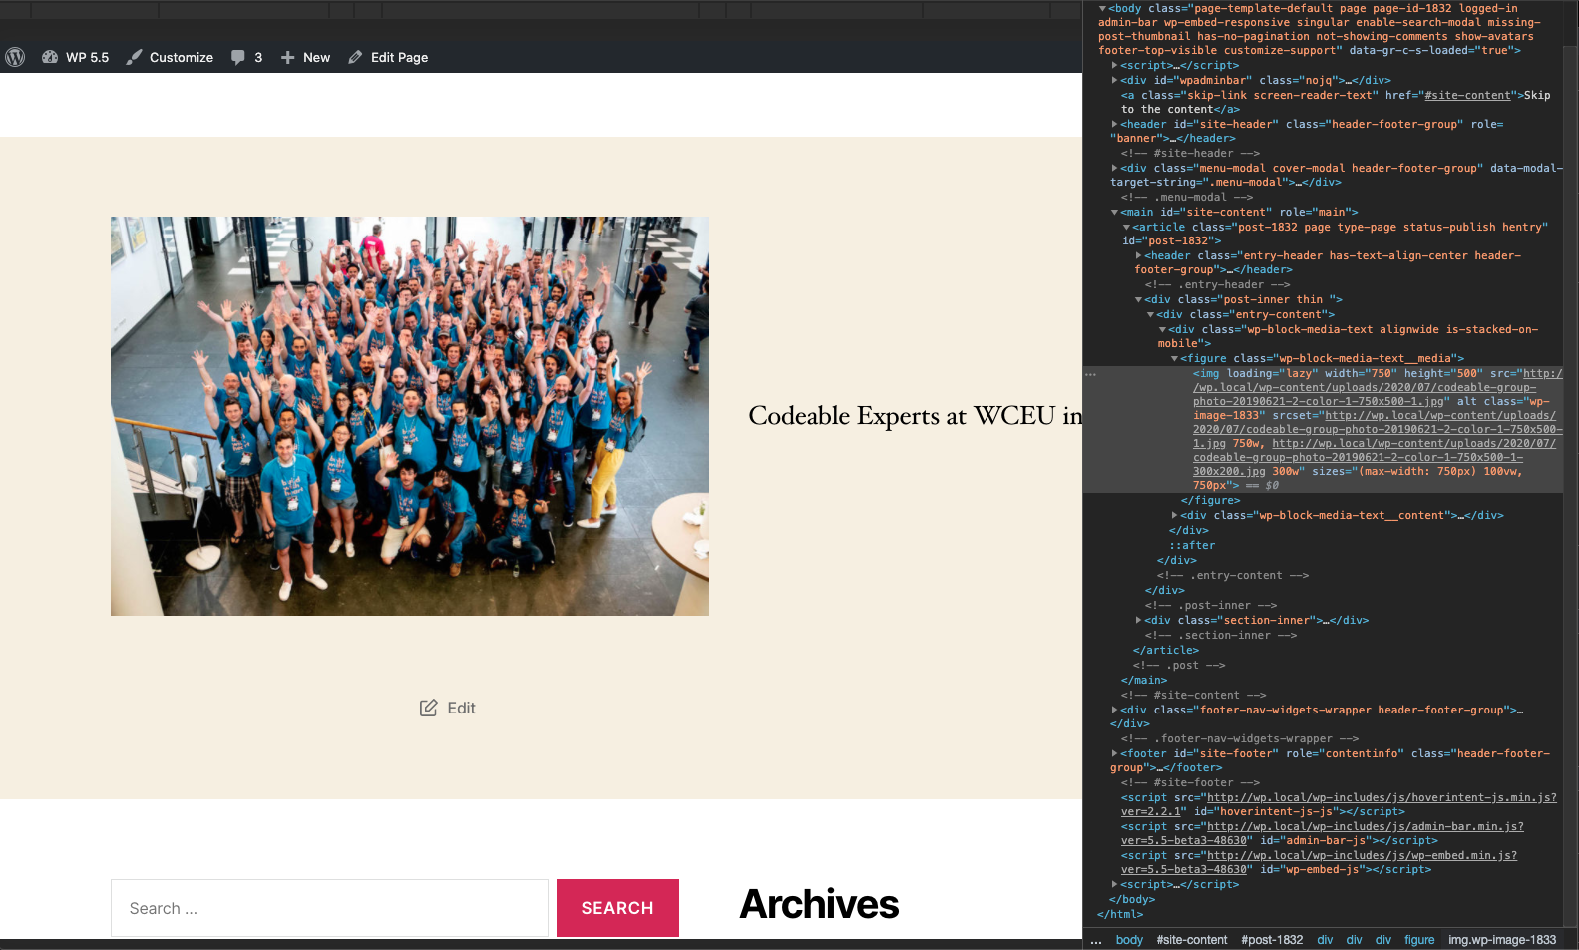
According to HTTPArchive, images are the most requested asset type for most websites and usually take up more bandwidth than any other resource. At the 90th percentile, sites send about 4.7 MB of images on desktop and mobile.
___
Native lazy-loading for the web, web.dev
Notes:
CHRIS - taking this
ACCESSIBILITY ISSUES ON THIS - need to replicate it without the picture behind.. Can we highlight the code
According to HTTPArchive, images are the most requested asset type for most websites and usually take up more bandwidth than any other resource. At the 90th percentile, sites send about 4.7 MB of images on desktop and mobile for each page. Even if we cannot imagine the success of any website without images, a lot of visitors are going for information firstly and we know full well that they have no patience to wait for the page to show up. So, lazy loading attribute on WordPress 5.5 promises better user experience in the first place.

Slide 13
4. Gutenberg
each new WordPress release brings tons of updates to the editor. This one will come with many such improvements and new features that will enhance your writing experience several folds.
UI improvements
Block Patterns
Inline image editing
Notes:
ABHA TO INTRODUCE THIS and then hand over to Nemanja
Segment these a bit more UI improvements - Nemanja Block patterns - Abha Inline image editing - Chris

Slide 14
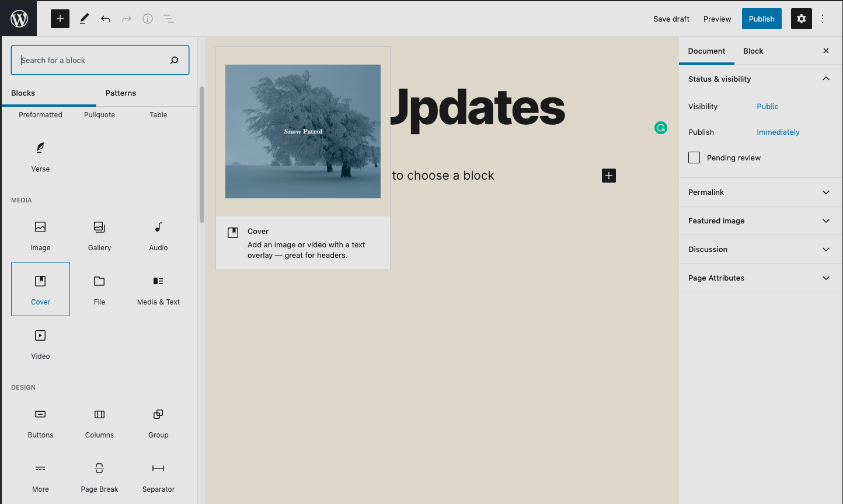
Tip
Borders around toolbars and buttons, new icons, and focus highlighting are introduced to improve UX.
Notes:
Nemanja
The rapid improvement of the block editor continues in WordPress 5.5. with numerous changes to the look and feel of the block editor “in the hope of simplifying iconography, color palette, focus, and general interface.”
If you are actively using Gutenberg you have already seen them.
If not here is quick sum up of improvements:
Simpler block toolbar, better UI color contrast, consistent focus styles, redesigned icons, grid-based spacing and sizes, previews

Slide 15
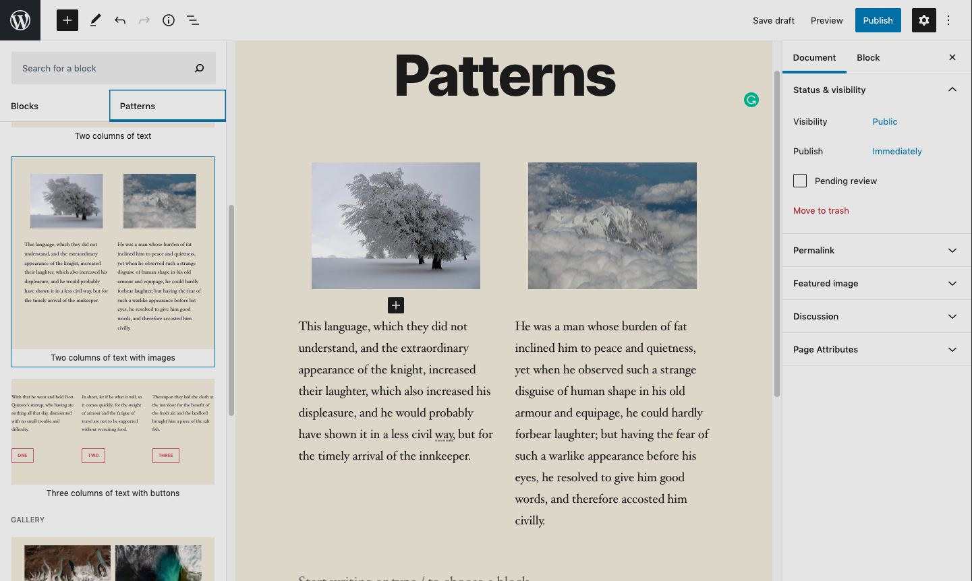
Tip
Block Patterns are predefined block layouts, ready to insert and tweak
Notes:
Abha & Anne
What is a Block Pattern?
A Block Pattern is one or several blocks that are organized and stylized. If a pattern contains several blocks you can remove them or move them around separately. Styling abilities are determined by the functionality of The Block Editor and your current theme.
What is the difference between a block pattern and a block?
Patterns are curated collections of blocks, often organized around a specific section or purpose. You don’t have to add each block within a pattern individually but can use the patterns that are available in the built-in Block Library. To share an analogy, getting blocks is like getting wood and nails whereas getting block patterns is like getting a house or picnic table ready to go.
What is the difference between a block pattern and a reusable block?
Block patterns come pre-built based on common use cases on the web and are a part of WordPress with the 5.5 release. Block patterns can’t be created by users and saved. On the other hand, reusable blocks are user-generated and heavily customizable based on what a user might want to add. Both features build on blocks as the smallest interaction unit and should make it easier for people to quickly customize their posts and pages.
Are block patterns reusable?
They’re not “reusable” as in Reusable Blocks, but you can add as many of the same pattern to as many posts or pages that you would like.
Where can I get more block patterns?
Right now, only a selection of block patterns is being added to WordPress. If you would like more, you can explore plugins that have their own block pattern library.
How is a block plugin different from a regular plugin?
A block plugin is a specific type of WordPress plugin that only adds a single block to your site whereas typically a plugin offers more robust functionality that impacts the entire website and not just a particular block.
Where can I find block plugins?
With the Block Directory being added as a new feature to WordPress 5.5, you can find block plugins by using the Inserter to automatically search for available block plugins to install. Separately, you can also review the currently available block plugins on the page ‘Plugins categorized as block patterns. https://wordpress.org/plugins/browse/block/
What will happen to a block pattern on my site if I switch themes?
If you change themes, the block patterns that were inserted into your post(s) will remain intact.
What if a block pattern that I’m using is changed?
It is possible that a Block Pattern you’ve used on your site is changed or even removed in the future. This will not impact your site because once you’ve added a Block Pattern to your site, it is not linked to the original pattern and any changes will not affect your site’s posts or pages.

Slide 16
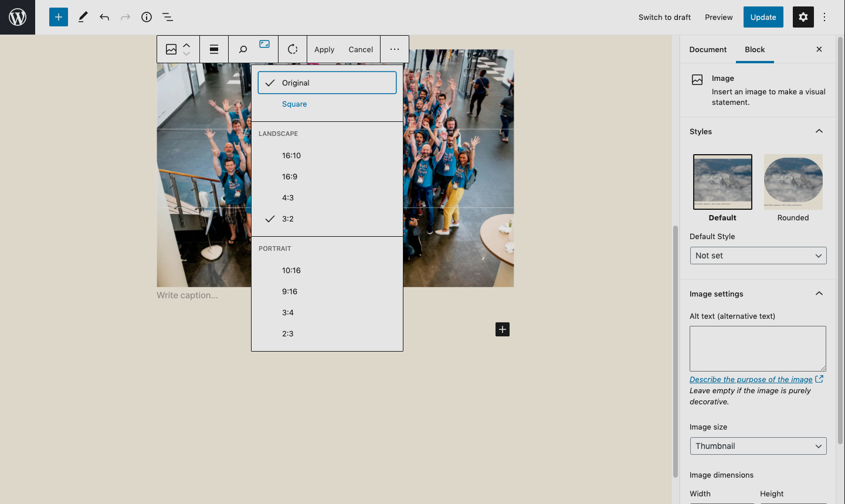
Tip
Do some basic image editing like crop, resize, rotate, and scale without opening media library
Notes:
Chris Inline image editing
How can I zoom an image in Block Editor?
You can achieve it by using the zoom tool in the Image block.
Below are the steps to zoom an image:
Add an image to the image block.
Select the crop tool from the toolbar. The crop tool will be extended with the new toolbar.
Select the zoom tool. It will display the slider tool with an aspect.
Use the slider to zoom in/out the image.
Click Apply to make the change to the image.
Click Cancel to discard the change.
How can I rotate an image in the Block editor?
You can rotate the image using the Image Block.
Below are steps to rotate the image:
Add an image to the Image block.
Select the crop tool from the toolbar. Crop tool will be extended with the new toolbar.
Select the rotate tool. It will rotate the image in the editor itself.
Rotate the image.
Click Apply to make the change to the image.
Click Cancel to discard the change.
How can I crop an image in Block Editor?
You can crop the image using the crop tool of the Image block.
Below are steps to crop the image:
Add an image to the Image block.
Select the crop tool from the toolbar. Crop tool will be extended with the new toolbar.
Select the aspect tool. It will list aspect ratio in a dropdown box. Aspect ratio can be set as per original, square, landscape and portrait of the image.
Select aspect ratio as per your requirement.
Move the image in the select aspect ratio to crop it.
Click Apply to make the change to the image.
Click Cancel to discard the change.
Can I upload external images in the Image block?
You can upload any external image directly from the image block.
Below are steps to upload external image:
Add the Image Block. There are three options to add the image.
Click the “Insert from URL” option. There is a prompt of a text box for pasting the image link address.
Copy the image link from external resources.
Paste the image link in the upload image text box.
The image block will display the image from the external resources.
Click on upload external image icon in the toolbar. It will upload the image into the media library.
What will happen if I change an image several times?
Each time you edit an image and then move out of the image editor, the image is saved in the Media library separately. This can increase the size of your site folder on a server. If you have limited space, please check directly with your Hosting provider on how to handle this.

Slide 17
5. The Block Directory
…
Simple search
Quick install
Notes:
Nemanja - block directory
Block plugins are small pieces of code - mostly JavaScript-based that outputs some HTML - that provide a block. They are searchable and installable from within the Gutenberg editor itself.
Regular plugins can add new features and significantly extend functionality, and you search for and install them from the Plugins menu. Block plugins impact a site at the page level while regular plugins mostly impact a site at the architecture and functionality level.

Slide 18
Notes:
Nemanja
With the new block directory, if you need to add a block to your page and you can’t find it on the list of blocks, you can use the search feature to discover, install and insert third-party blocks to your page.
When editing a post or page, on the top right corner you will see a plus ‘+’ sign that says “Add Block” when you hover over it. Click on it and you will see a search bar that says “search for a block”. You can enter the name of the block you’re looking for, or simply a keyword, just like you do when searching for regular plugins. If you see the block you want, just click on ‘Add Block’. If you get an error message such as “Error registering block. Try reloading the page.”, click on the ‘reload’ button which will load the page again, and you should be able to access your block plugin immediately.

Slide 19
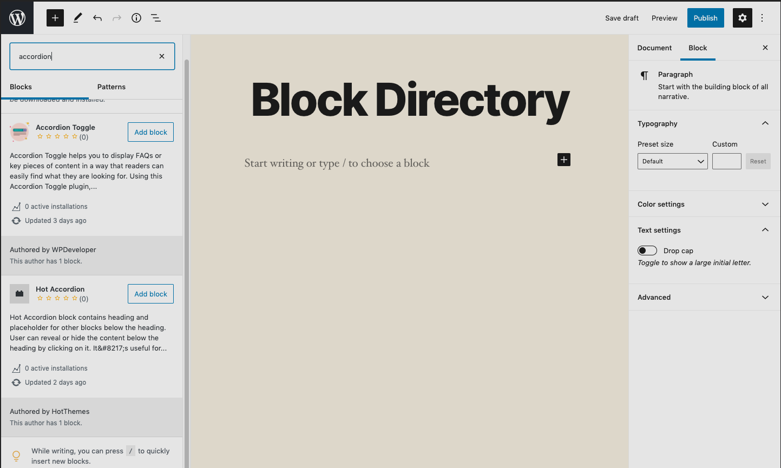
Tip
Block directory makes it possible to easy search and install block you need at the moment.
Notes:
Nemanja : Block directory
Few remarks on using block directory:
If you don’t have an Administrator role in your WordPress site, you don’t have permission to add plugins, nor can you add new blocks directly from the block directory. You will need to ask your site administrator to install any new blocks.
Blocks plugins will appear in the Plugins list page along with your regular plugins, and you will be able to activate or delete them from that page.
Blocks make creating and editing posts and pages easier for users. You can safely and seamlessly install block plugins without having to leave the Editor, instead of going through the process of saving what you’re working on and then going over to the Plugins menu. Just search for the block, add it, and continue with your work.

Slide 20
HUGE thanks to everyone in the community who participated in WordPress 5.5 and subsequent minor releases.
Notes:
We need to remove the picture for accessibility

Slide 21
This presentation, accompanying slides, questions and answers on the releases, and social media posts on the new features are all available for WordPress Meetups to use and adapt.
Thanks to the Make WordPress Marketing Team and members of other teams who worked on these resources.
Produced September 2020
Notes:
We need to remove the picture for accessibility

Slide 22
Thank you!
QUESTIONS
Notes:
Abha

